Slide 1
Chapter 2 Vocabulary
Tanner & Andres

Slide 2
Remembering New Words
Associate words in phrases: Rather think of the word & record it in a phrase that suggests it meaning.
There are five remembering skills:
Associate words with rhymes or sounds: link the sound of a new word with a rhyming word or phrase. The brain appreciates connections and patterns.
Associate words with images: Expand the phrase chosen for learning the word into a vivid mental image. Create a situation or an episode for the word. Furthermore, enrich your memory link by drawing mental images.

Slide 3
Remembering New Words Cont.
Associate words in families: words like people, have families that share the same names. In the cases of words the names are called prefixes, roots and suffixes.
Seeking Reinforcement: Look and listen for your new words you will probably discover that they are used more frequently that you thought.
Create concepts cards: Many students use index cards to record information on new words

Slide 4
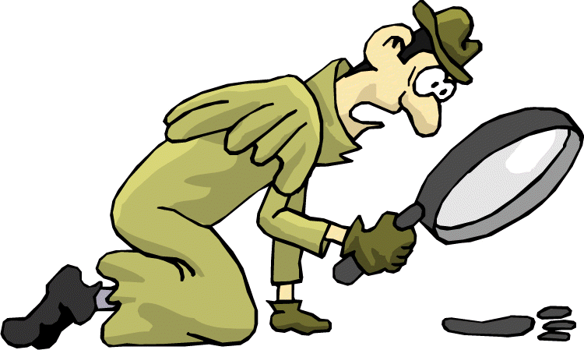
Using Context Clues
Using context clues is the most common method of unlocking the meanings of unknown words.

Slide 5
Learn Prefixes, Roots, and Suffixes
Words are like families, clusters or some sort may be called word families are composed with the same base or ROOT.
Prefixes and suffixes are added to root words to change the meaning.
Prefix: is added to the beginning of the word
Suffix: is added at the end of the word
Example:
Pneumonoultramicroscopicsilicovolcanokoniosis

Slide 6
Example
Pneumono: Pertaining to the lungs, as in pneumonia
Ultra: Beyond, as in ultraviolet rays
Micro: Small as in microscope
Scopic: From the root of Greek verb skpein, to view or look at
Silico: from the element silicon, found in quartz, flint, and sand
Volcano: the meaning of this is obvious
Koni: the principal root, from a Greek word for dust
Osis: a suffix indicating illness

Slide 7
What to Find in a Dictionary
GUIDED WORDS: The two words at the top of each dictionary page are the first and last entries on the page. They help guide your search for particular entry by indicating what is covered on the page.
PRONUNCIATION: The boldface main entry divides the word into sounds, using a dot between each syllable. After the entry, letters and symbols show the pronunciation. A diacritical mark (‘) at the end of a syllable indicates stress on that syllable. A heavy mark means major stress; a lighter one indicates minor stress.

Slide 8
What to Find in a Dictionary
PART OF SPEECH: The part of speech is indicates in an abbreviation for each for each meaning of a word. A single word, for example, may be a noun with one definition and a verb with another. The noun flamingo can be used as only one part of speech, but sideline can be both a noun and a verb
SPELLING: spellings are given for the plural of the word and for special forms. This is a particularly useful in determining whether letters are added or dropped to form the new words. The plural of flamingo can be spelled correctly in two different ways. Both flamingos and flamingoes are acceptable.

Slide 9
What to Find in a Dictionary
ORIGIN; for many entries, the foreign word and language from which the word was derived will appear after the pronunciation. For example, L stands for Latin origin and G for Greek. A key for the many dictionary abbreviations usually appears at the beginning of the book.

Slide 10
Example
fla·min·go
/fləˈmɪŋgoʊ/ Show Spelled[fluh-ming-goh] Show IPA
noun, plural fla·min·gos, fla·min·goes. any of several aquatic birds of the family Phoenicopteridae, having very long legs and neck, webbed feet, a bill bent downward at the tip, and pinkish to scarlet plumage.
Origin: 1555–65; compare Portuguese flamengo, Spanish flamenco literally, Fleming ( compare flamenco); apparently originally a jocular name, from the conventional Romance image of the

Slide 11
What’s A Glossary
The glossary defines the words as they are used in the textbook. Its at the end of most textbook is in the index which helps you find topics you are discussing.

Slide 12
What is a Thesaurus
Thesaurus is a writers tool. It provides synonyms that is words similar in meaning for the word look up.

Slide 13
What are Acronyms
ACRONYMS: is an abbreviation that is pronounced as a word. Acronyms can thus be considered invented words that are often thoughtfully contrived to simplify a lengthy name and gain quick recognition fir an organization or agency.
EXAMPLE: UNICEFF (United Nations International Children’s Emergency Fund)

Slide 14
What are Analogies
ANALOGIES: are comparisons that call upon not only your word knowledge but also your ability to see relationships. They can be difficult, frustrating, and challenging. Use logical thinking and problem-solving skills to pinpoint the initial relationship, and ten establish a similar relationship with two other words.

Slide 15
Reader Tips
Synonyms: Similar in meaning find is to locate as hope is to wish
Antonyms: Opposite in meaning accept is to reject as rude is to polite.
Function, use, or Purpose: Identifies what something does: watch for the object (noun) and then the action (verb) Pool is to swim as blanket is to warm.
Classification: Identifies the larger group association sandal is to shoe as sour dough is to bread.

Slide 16
Reader Tips
Characteristics and descriptions: shows qualities or traits Nocturnal is to raccoon as humid is to rainforest.
Degree: Shows variations of intensity Fear is to terror as dislike is to hate.
Part to whole: shows the larger group Page is to book as caboose is to train.
Cause and effect: Shows the reason (cause) and Results (effect) Study is to graduation as caffeine is to insomnia.

Slide 17
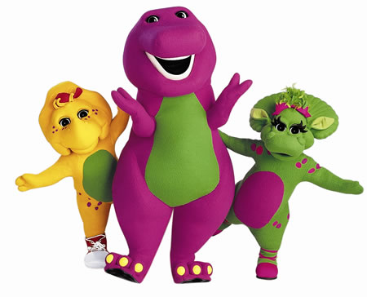
How Are Transitions Words Used
Transitional words connect ideas and signal the writers train of thought.

Slide 18
Readers Tips: Types of Transitional Words
To signal addition: in addition, furthermore, moreover
To signal an example: for example, for instance, to illustrate, such as
To signal time sequence: first, second, finally, last, afterward
To signal comparison: similarly, likewise, in the same manner
To signal contrast: however, but nevertheless, whereas, on the contrary , conversely, in contrast
To signal cause and effect : thus, consequently therefore, as a results, furthermore, similarly, consequently, however, for example.

